Slide 1
Governmental impacts on U.S. poverty：
A time series regression analysis on US poverty records since 1950s
Boyang Li
"The Economics of Ultra-poverty: Causes and Remedies“
March 22, 2012
The Elliott School. George Washington University

Slide 2
Research goals
Understand historical development on poverty
Find out the key factors that lead to the stable poverty rates.

Slide 3
Background
US economic inequality (Smeeding, 2005)
SOCIAL POLICY & U.S. POVERTY 1960-1999 (Jaynes, 2011)
Comparative study on US poverty issues (Wallace & Meyer, 2009)
Framing the Poor Media Coverage and US Poverty Policy, 1960–2008 （M. Rose, A. Fellow, 2012）
Real income & Low taxation (Henry C.K. Liu,2009)

Slide 4
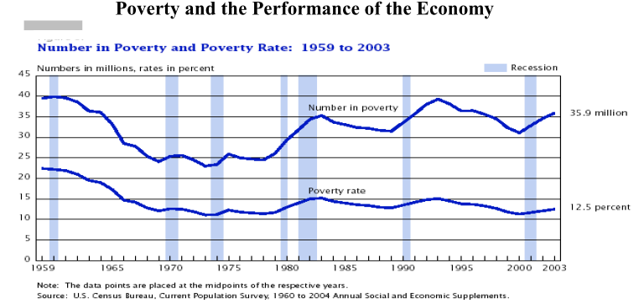
Historical Figure: Poverty Rate
(US economic inequality, Smeeding, 2005)
Notes:
1959 — 22.4 percent. The government begins tracking the percentage of the population living in poverty. More than a fifth of Americans are categorized as poor.
1964 — 19 percent. President Lyndon Johnson started War on Poverty. That war included iterations of or precursors to Job Corps, Volunteers in Service to America (VISTA), Upward Bound, Head Start and the food stamp program.
1973 — 11.1 percent. Thanks largely to Johnson's Great Society and War on Poverty programs, the poverty rate temporarily dropped to the lowest in history.
1983 — 15.2 percent, inflation. And stagflation.
1989 — 13.1 percent, at the end of Regan era, USA enjoyed an economic boom and, as a result, a dropping poverty rate, but not enough.
2000 — 11.3 percent, Welfare reform, President Clinton implemented a new market-driven welfare policy. put more poor people into labor market
2009 — 14.3 percent, That's the greatest number of people in poverty in the five decades the government has been recording data and the highest poverty rate since 1994

Slide 5
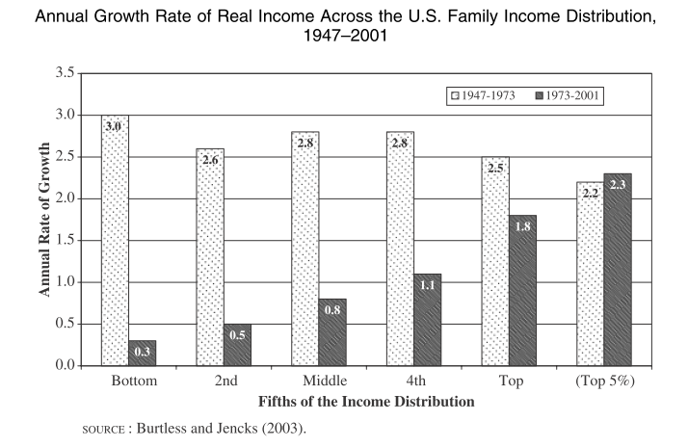
Historical Figure: Income distribution
(US economic inequality, Smeeding, 2005)

Slide 6
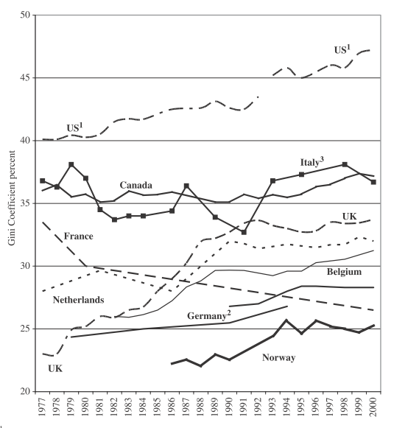
Historical Figure: International Gini Coefficient
(US economic inequality, Smeeding, 2005)

Slide 7
Poverty： two types of reasons
Economic Factors：
Unemployment
Income Distribution
Shift in Business Economy
Individual Factors：
Lack of Education (or Skill)
Breakdown of Family System
Lack of Willpower
Notes:
Shift in Business Economy
Earlier, American economy was greatly dependent upon manufacturing industries such as steel, textile, automobile etc. These industries provided number of opportunities to uneducated but capable labor. However, this scenario has been changed by the emergence of new economical sectors such as Health Care and Information Technology. As a result of this, the reliance of American economy on traditional manufacturing sector reduced. These sectors demanded highly educated and trained professionals. This eventually, led to loss of business opportunities for the minimally educated workforce. On the other hand, some emerging countries such China, Brazil also
Unemployment
Although, unemployment is one of the cause of poverty, actually it is an altogether different social issue. Unemployment stems from various social, economical conditions. As mentioned above, shift in business economy is one cause of unemployment for a particular section of society. However, apart from that, there are several other factors which lead to unemployment, such cyclical market fluctuations or personal reasons. It is hard to ignore that majority of impoverished people are either unemployed or only part-time employed. Only 2.5% of poor people come from a full-time workforce. These figures indicate how a person's financial state is influenced by his employment status.
Lack of Education, Skill
Lack of education such as high school dropouts flatly translates to lack of employment opportunities, which eventually leads to poverty. For example, as the demand for laborious jobs diminished, uneducated people were left in poverty. As these people neither had education nor did they acquire any skills required to sustain in changed economical scenario, they were driven into the vicious circle of poverty.
Breakdown of Family System
Increased divorce rate means more number of families headed by women alone. Often, these women are unable to take care of their families all by themselves. These families always come along with insufficient educations and children poverty. So Lack of education, unplanned pregnancies compounds the problems of single women. As a result, they cannot find suitable employment to run their homes. Obviously, the entire family then gets dragged into poverty.
Lack of Willpower
The constant rate of poverty over decades indicates that there is no enough willpower to address this issue, either at personal level or at governmental level. Some sections of poor people make no attempts to improve their condition whatsoever. They not only force their children to live in poor conditions, but they also pass this unfortunate attitude to them. The end result is, generations of poor people living in destitute conditions. These people are reluctant to interact on a social level, thereby thwarting all attempts to improve their living condition.

Slide 8
Reduce Poverty: increase income
Income Growth
Economic Growth
How to explain the growth of number of poverty? Who are becoming poor?

Slide 9
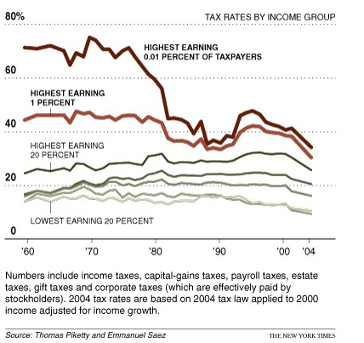
Historical Figure: Tax rate
(NYTimes,2007)
Notes:
From the perspective of government, we can see this problem indirectly: Since 1960s, the total federal tax has fallen for low earners, risen for relatively high earners and fallen significantly for very high earners.

Slide 10
problem
How to guarantee sufficient government investment on poverty group under a low taxation policy scenario?
Will the middle class be more “vulnerable” if the tax rate become higher?
Notes:
。
There are many argumentations about that there are more and more middle class people became poor since the economic crisis of 2008, we want to evaluate if the increasing poverty trend is determined by the current tax structure.
If so, maybe we should re-consider the current tax policies.

Slide 11
ANALYSIS
Dependent variable:
Poverty rate
Independent variables
Governmental deficit
Expansion (or compression) of government departments
Social welfare transfers
Inflationary
Tax rate for high, middle and low earners
Notes:
So, there is my regression mode: one dependent variable and 7 independent variables.
We want to use this model to make a statistic result if governmental financial policy had impact on poverty rates.

Slide 12
Question & Thank you
Boyang Li
George Mason University
bli4@masonlive.gmu.edu
Notes:
Presentation Notes (i.e. full script) go here, but they will need to be printed (PPT with notes). Be specific. What, exactly, are you planning to say during the time that each slide is showing?

